Slide 1
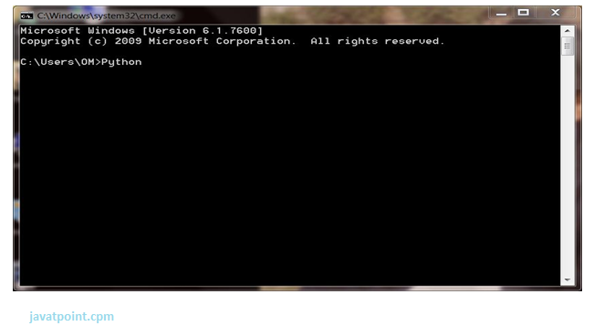
1) Interactive Mode
Python provides Interactive Shell to execute code immediately and produce output instantly. To get into this shell, write python in the command prompt and start working with Python

Slide 2
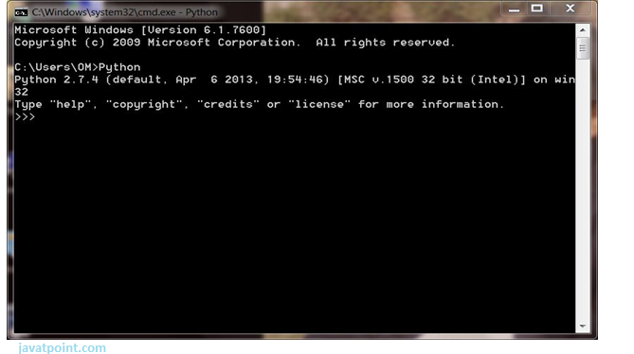
Press Enter key and the Command Prompt will appear like:

Slide 3
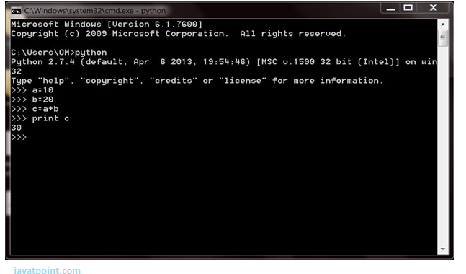
Now we can execute our Python commands

Slide 4
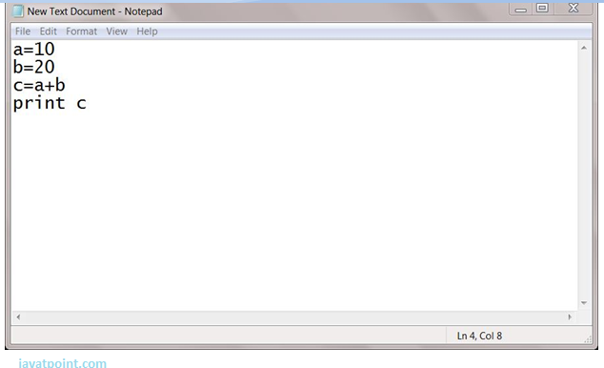
2. Script Mode
Using Script Mode, we can write our Python code in a separate file of any editor in our Operating System. Save it by .py extension

Slide 5
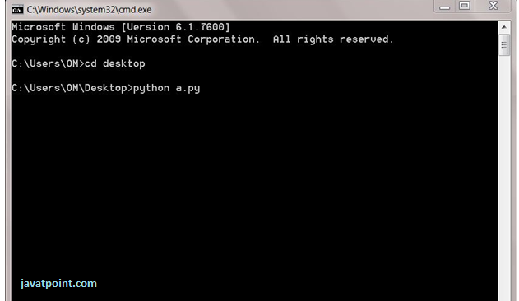
Now open Command prompt and execute it by :

Slide 6
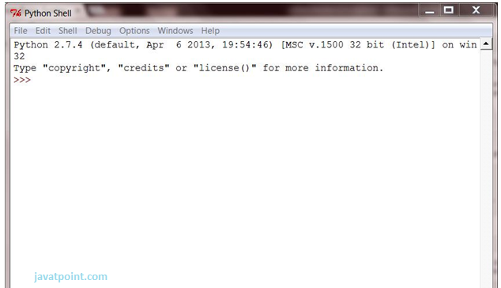
3) Using IDE (Integrated Development Environment)
We can execute our Python code using a Graphical User Interface (GUI).
All you need to do is:
Click on Start button -> All Programs -> Python -> IDLE(Python GUI)

Slide 7
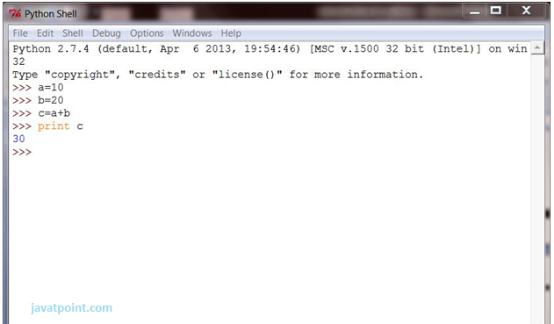
We can use both Interactive as well as Script mode in IDE.
1) Using Interactive mode:

